Slide 1
Visual Question Answering
Increment#2
Team Members:
Avni Mehta
Santosh Yadav Jada
Harshil Lavjibhai Patel
Trinadha Rajeswari Muppala

Slide 2
Objective
Dataset
To implement the visual question answering system that would answer open ended free-form questions of natural language like English.
The model will be trained on thousands of images in order to extract the important features of these images using CNN and Inception.
The most famous dataset for VQA is MS COCO dataset.
Owing to lack of hardware resources, we will use a small subset of the dataset.
Domain selected : Interiors

Slide 3
Feature Specification
In this project increment, we have mainly focused on the Deep learning models (SoftMax, CNN) for our for interiors (bedroom, bathroom, kitchen, living) data.
Converted data to ubyte.
Compared accuracy with Random Forest Model, Clarify API.
SoftMax, CNN with different number of epoch and CNN AdamOptimizer, AdagradOptimizer
Development of web application using HTML,CSS,Bootstrap,Ajax and Jquery.

Slide 4
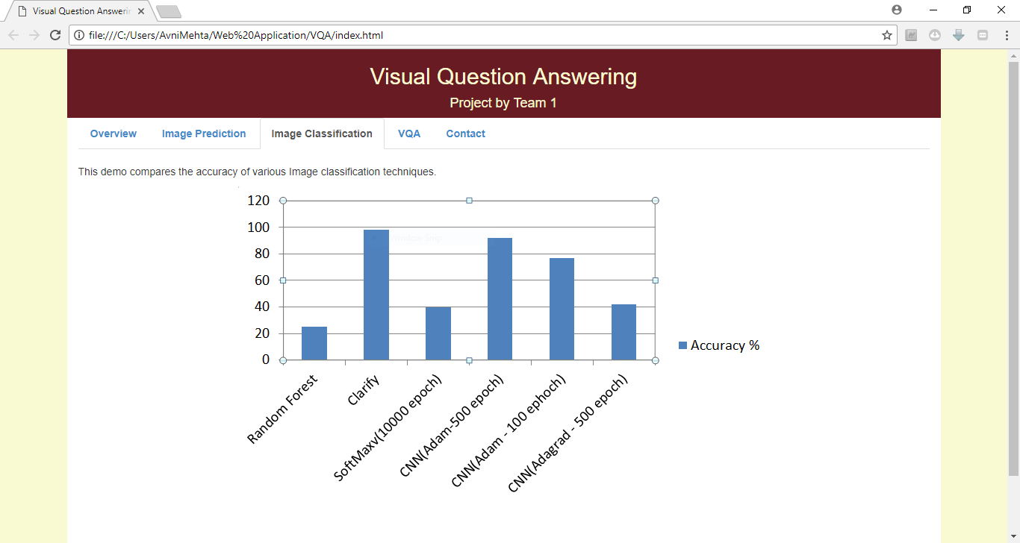
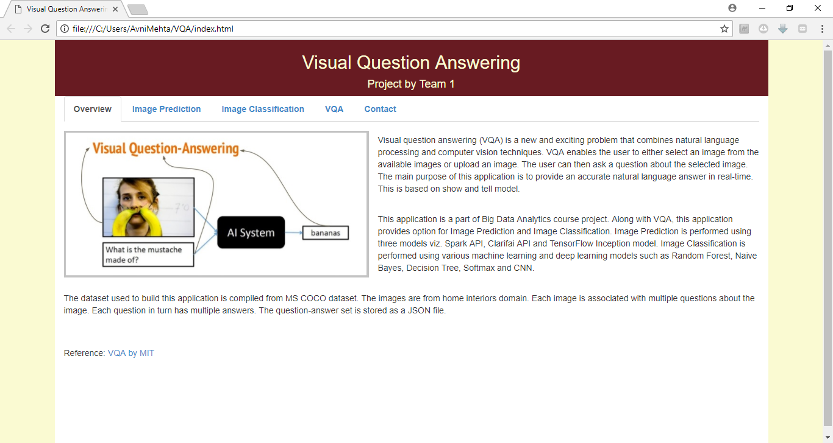

Slide 5
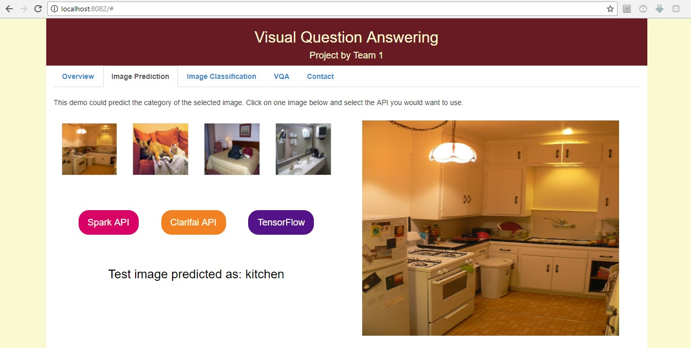
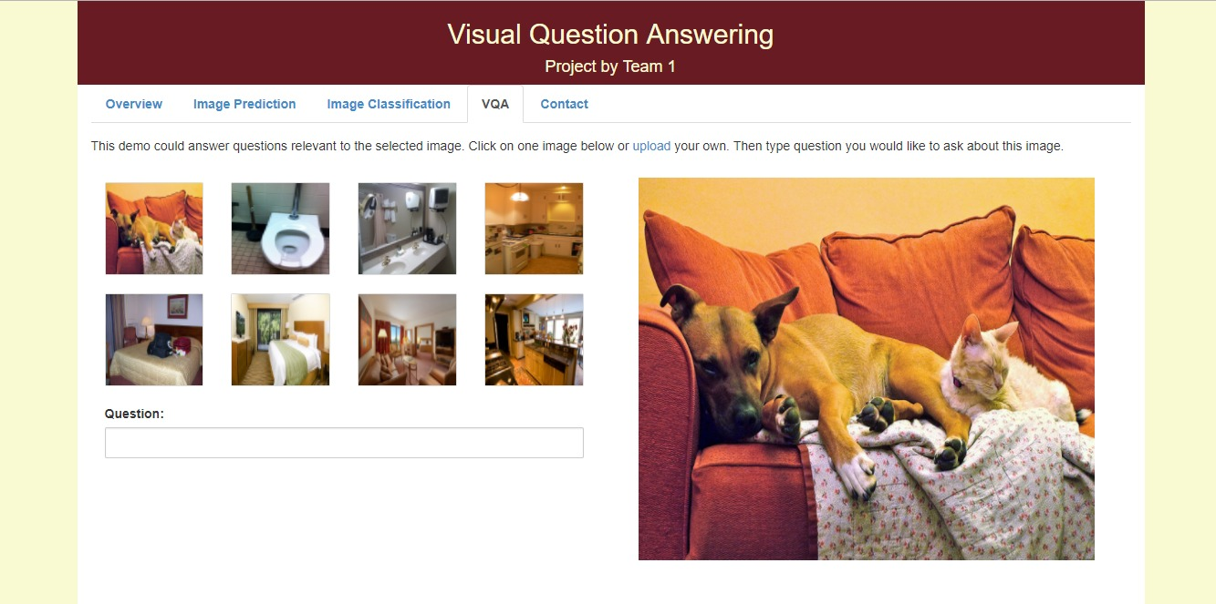

Slide 6
Next steps..
Image Classification using deep learning models (Inception).
Testing with VQA
Integration of the web model to the deep learning model.
Challenges!
Extracting the features of images.

